Slide 1
How Communication, Courtesy and Fun helped Hayden find it’s happy place
SOWING THE SEEDS
OF CHANGE

Slide 2
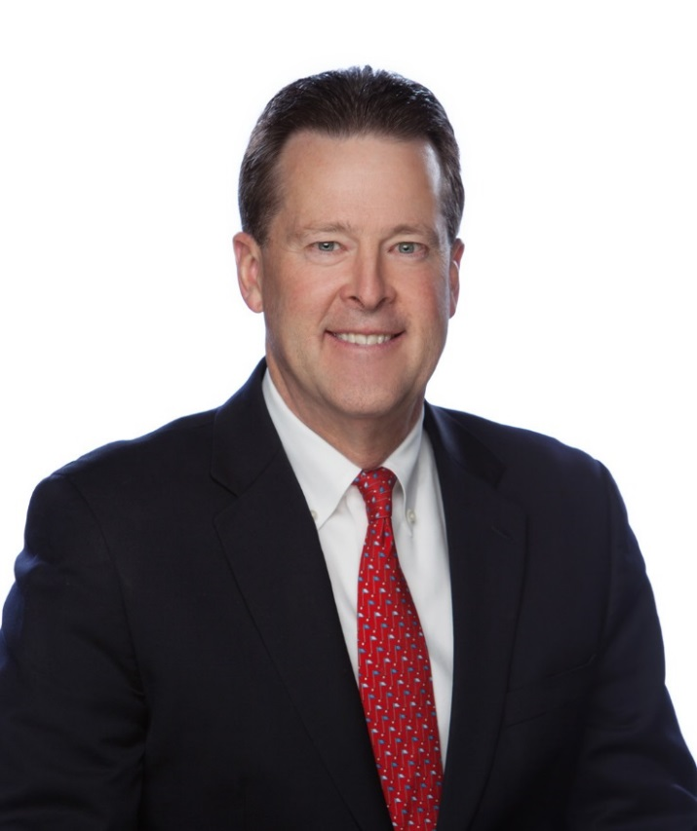
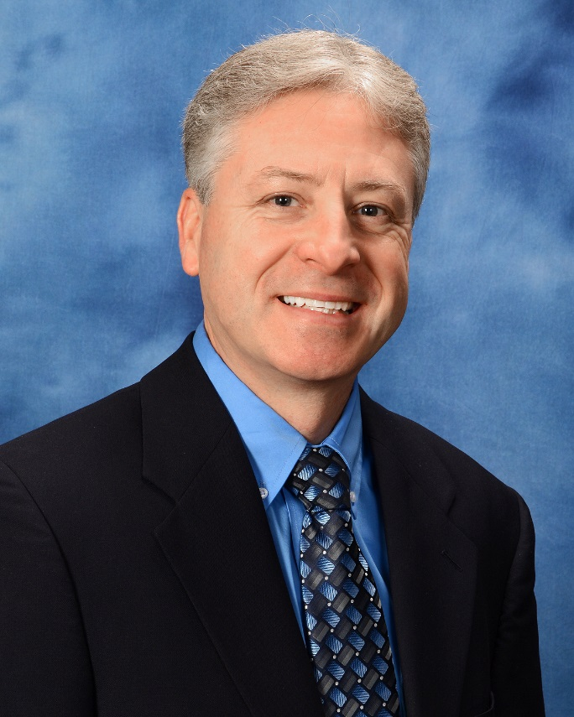
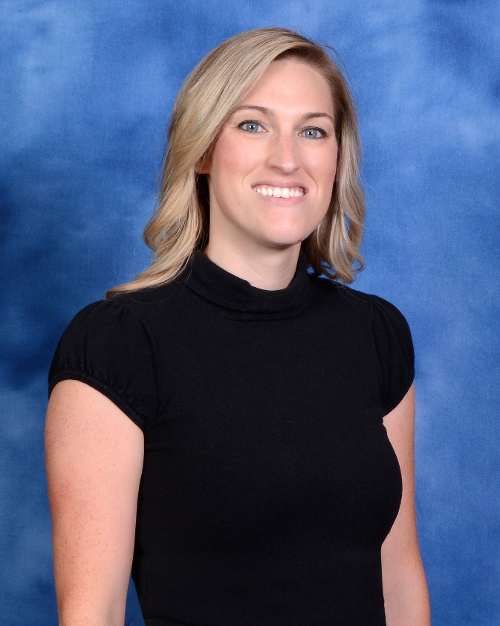
Population ~15,000
35 Permanent Employees

Slide 3
“Hayden was a difficult place to get projects approved”
"Hayden should be the easiest and most efficient city to do business with. Our goal is to achieve that distinction. We need department leaders and staff to be efficient, knowledgeable and grateful for the opportunity to serve our constituents."
CDA PRESS – January 2016

Slide 4
Let’s Talk
Monthly Meetings
Stay Interviews
Goal Setting
How to Recognize

Slide 5
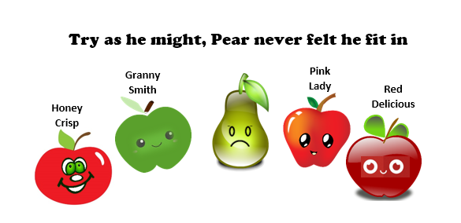
Play Nice

Slide 6
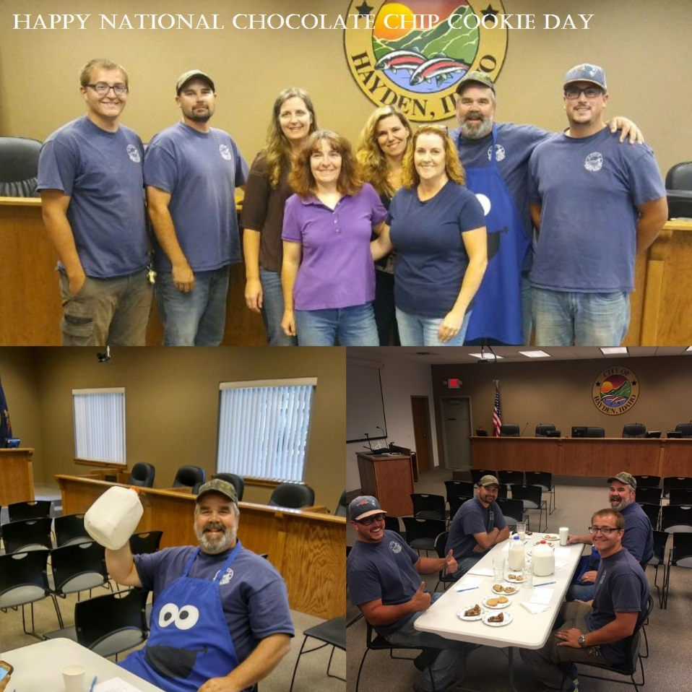
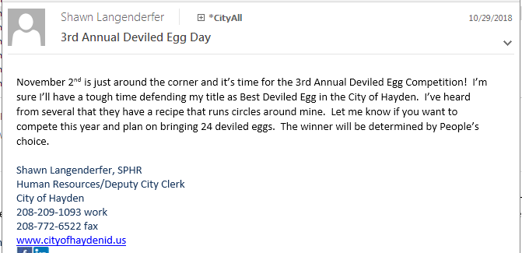
Have Fun!

Slide 7
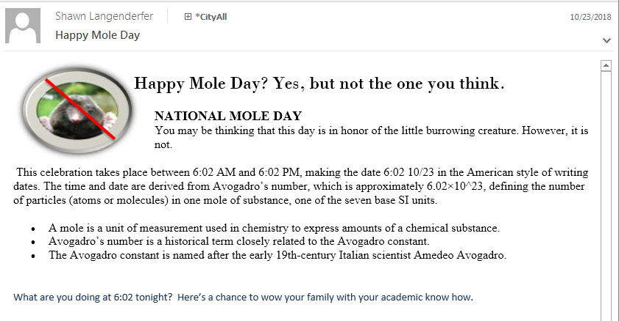
Celebrate Anything

Slide 8
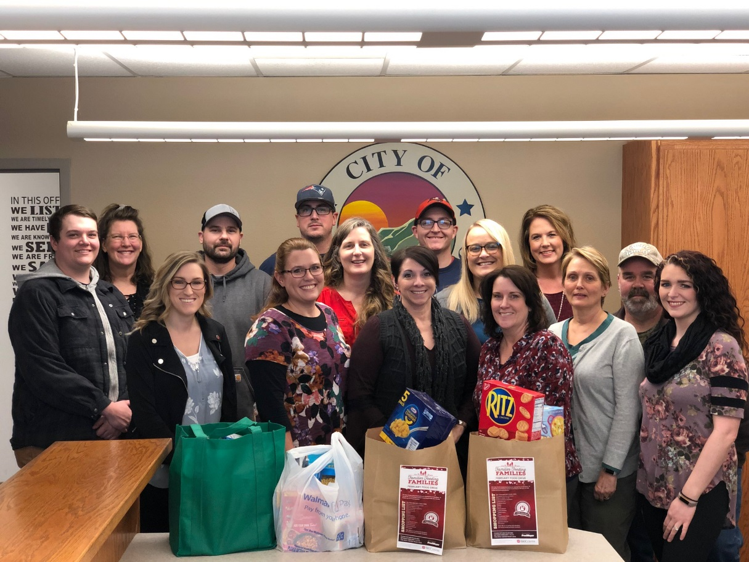
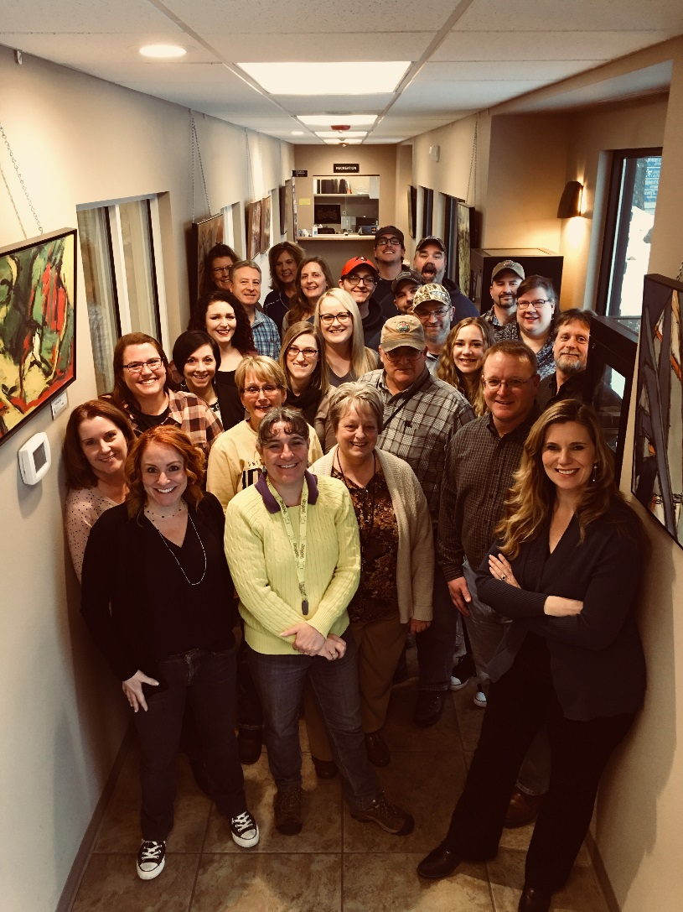
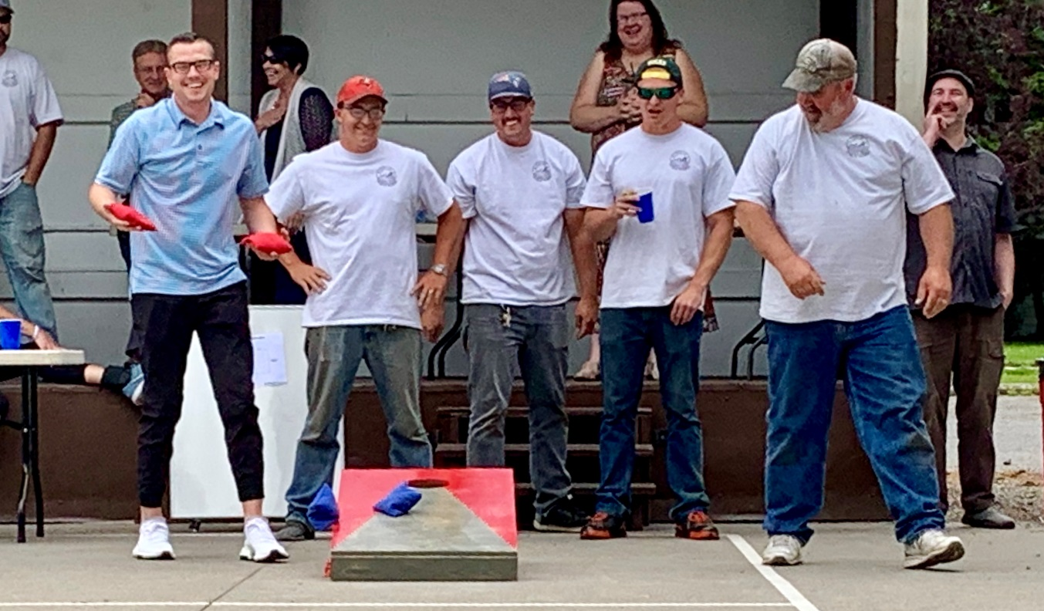
Come Together

Slide 9
John Chapman forever changed the apples of America.
"It was the seeds, and the cider, that give the apple the opportunity to discover by trial and error the precise combination of traits required to prosper in the New World," Michael Pollan – The Botany of Desire

Slide 10
Thank You
Shawn Langenderfer
slangenderfer@cityofhaydenid.us
208-209-1093

Slide 11
Encore

