Slide 1
Building & Sustaining Excellence
aerofliteinc.com

Slide 2
Leadership is Highly Situational
Leaders who succeed in one context …
won’t necessarily succeed in a different context
“There is no Colonel Sander’s
Secret Recipe for Success”
aerofliteinc.com

Slide 3
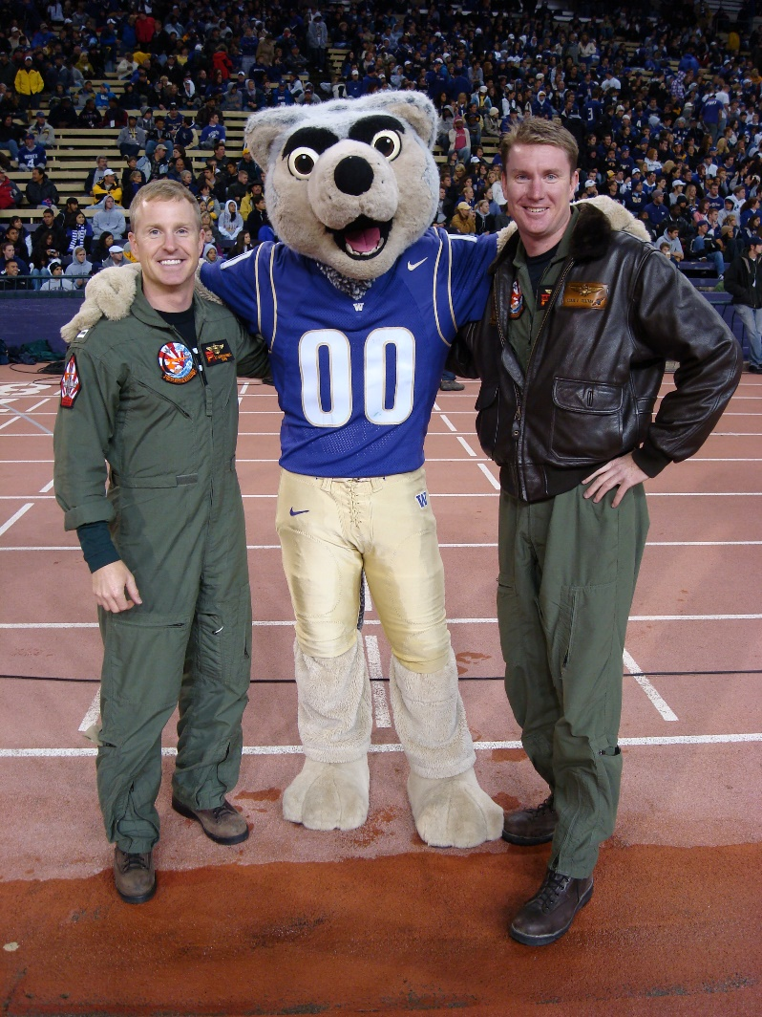
A Little Context on Who I am…
B.S. Mechanical Engineering
University of Washington
Master of Aeronautics
Embry Riddle Aeronautical University
Executive MBA Candidate
Washington State University
aerofliteinc.com

Slide 4
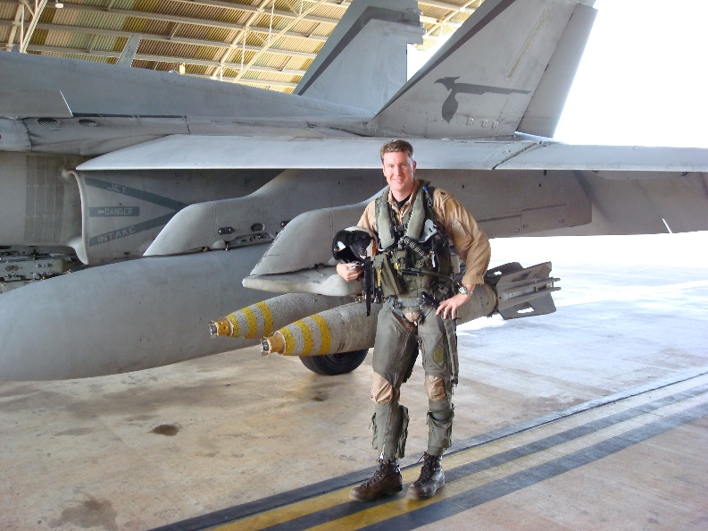
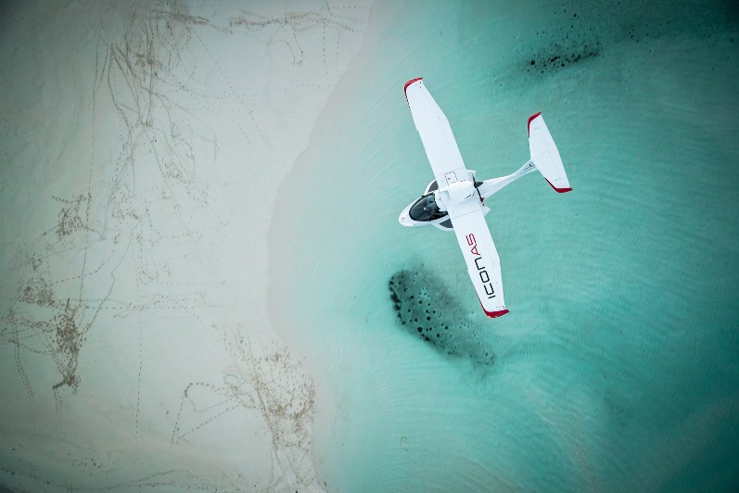
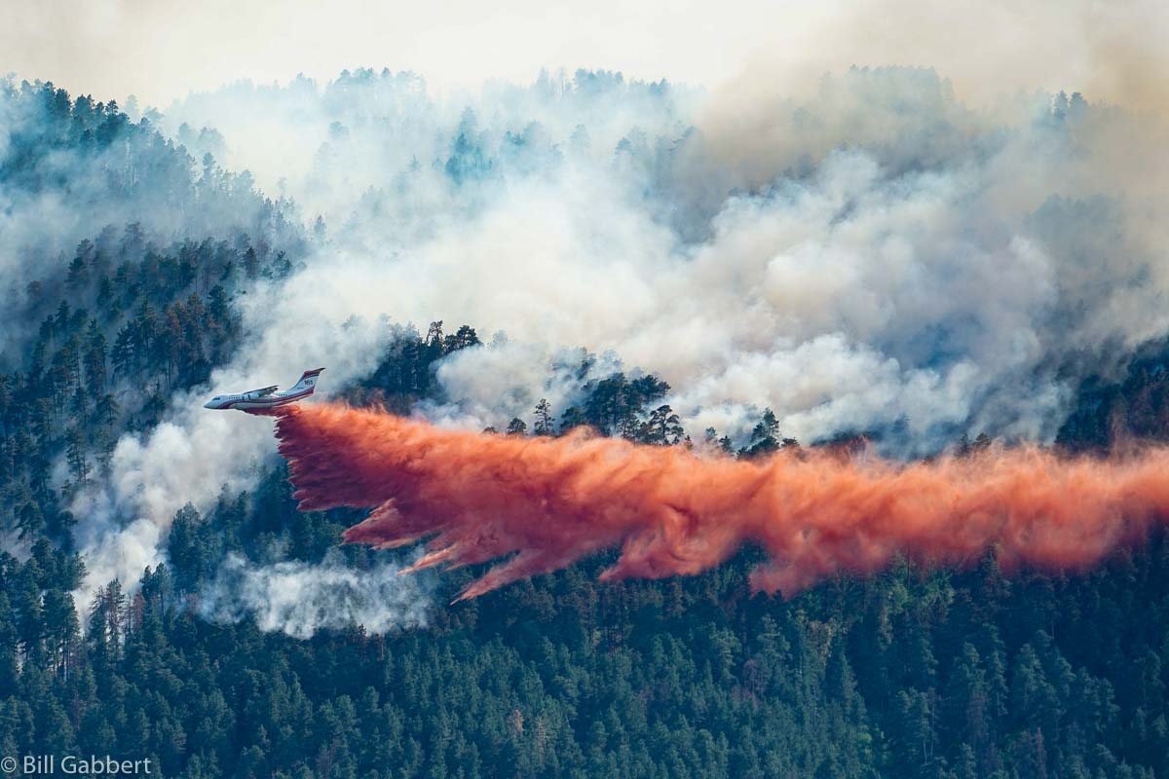
A Little Context on Who I am…
Retired U.S. Navy Squadron Commander
Chief Pilot, ICON Aircraft
General Manager, Aero-Flite
aerofliteinc.com

Slide 5
#1 Have a Vision & Purpose
The Team Cannot get somewhere unless they …
Know where they are going,
And Why…
“The two most important days in your life are the day you are born and the day you find out why.”
-- Mark Twain
aerofliteinc.com
Notes:
It’s not what you do, it’s how you do your job and why …

Slide 6
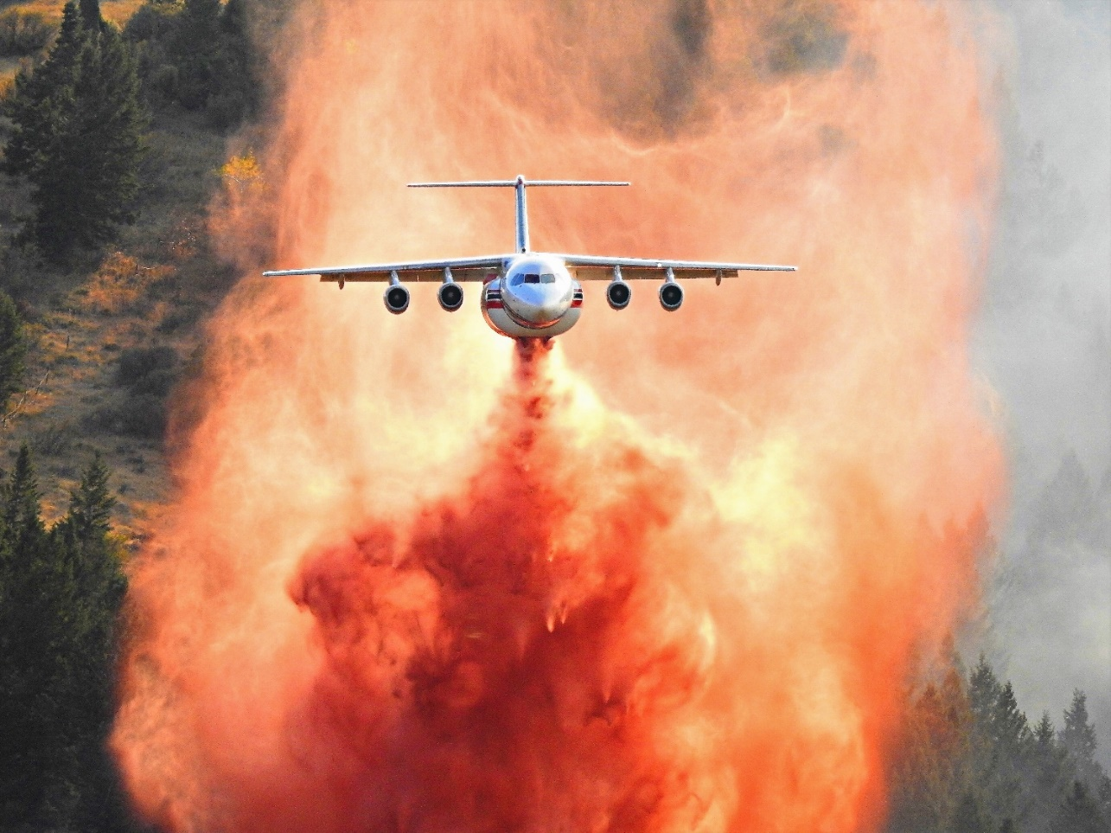
#2 Morale Matters
The team must believe ….
What they do is important!
They are the best at what they do!
What they do is appreciated!
aerofliteinc.com

Slide 7
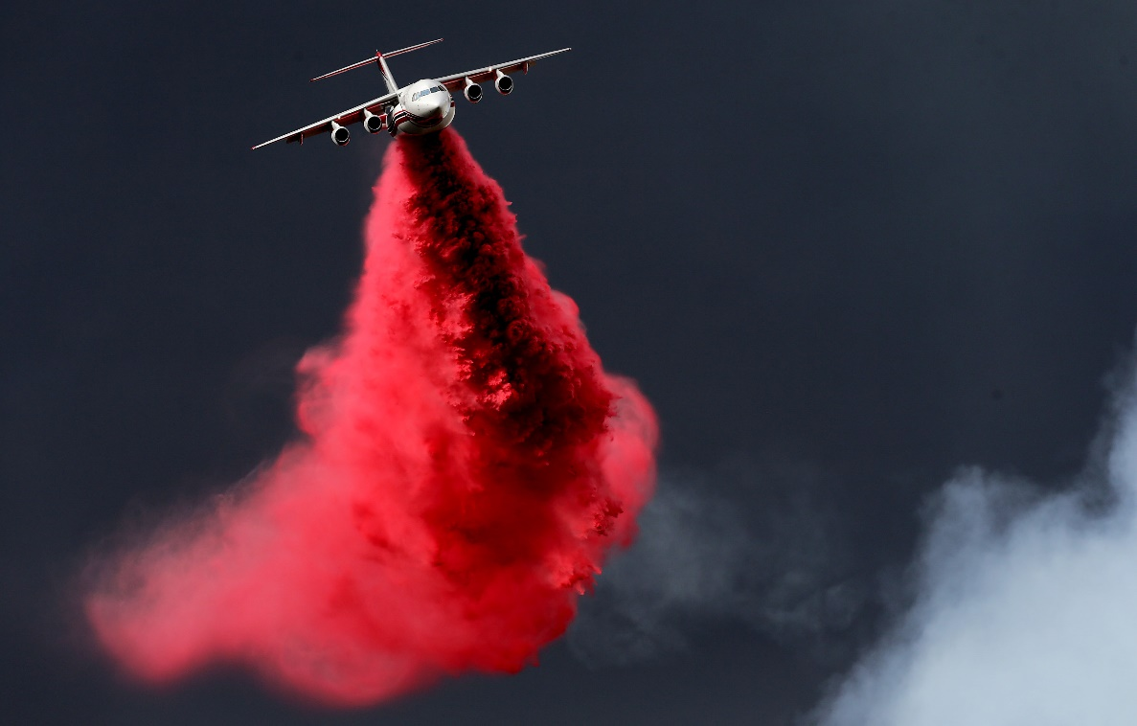
#3 Leadership is Hard
“Anyone can hold the helm when the sea is calm.”
– Publilus Syrus
aerofliteinc.com
Notes:
Whoever said leadership was easy! If they did, they were not truthful…

Slide 8
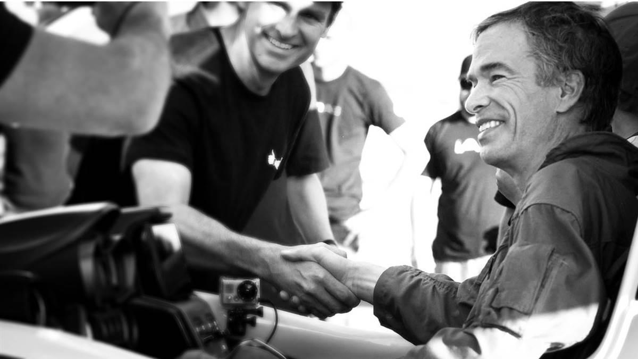
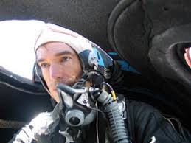
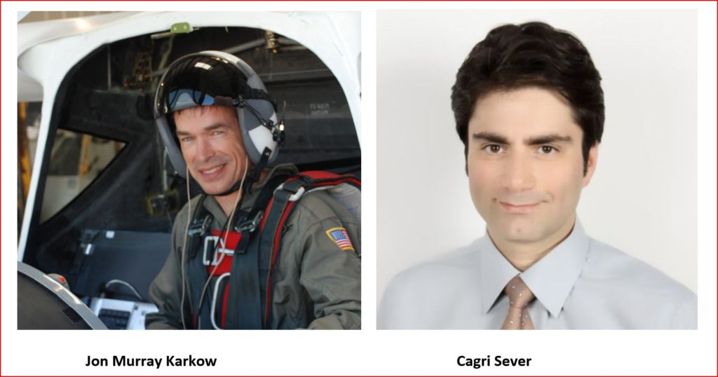
When it’s hard it matters the most
aerofliteinc.com

Slide 9
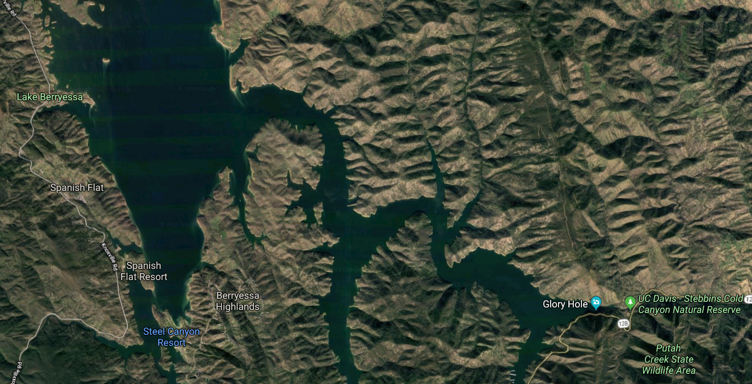
When it’s hard it matters the most
aerofliteinc.com

Slide 10
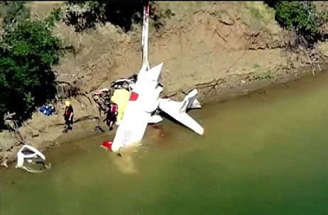
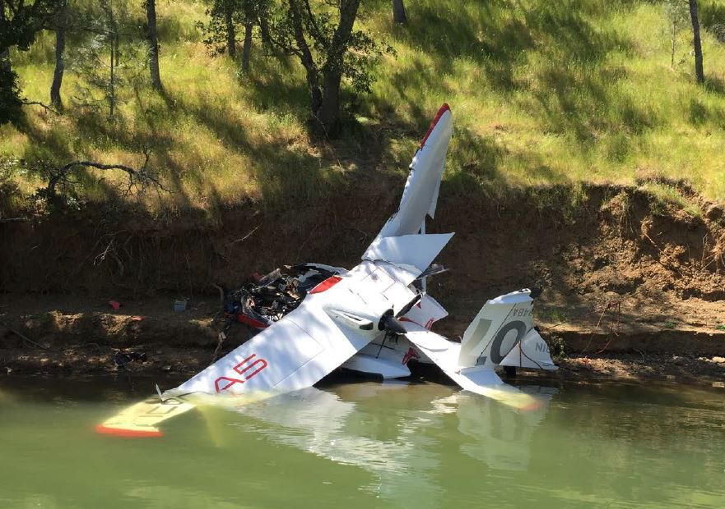
When it’s hard it matters the most
aerofliteinc.com

Slide 11
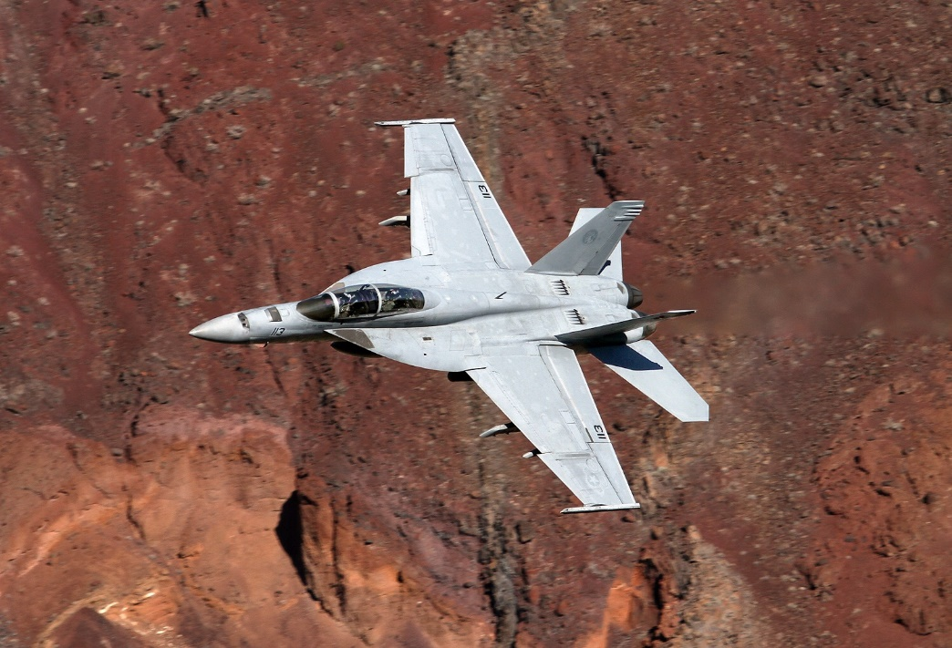
#4 Empower the Team & Share Credit
Include the team in Decision Making – Achieve Buy-in
Delegate then provide Resources & Authority
Refuse to Micro-Manage, however…
“Trust, but Verify.”
-- Ronald Reagan
Give them the Credit
aerofliteinc.com
Notes:
The Team’s Personal & Professional Success is the Organization’s Success … your Success…
Let’s be honest they’ve done the work
“A leader is best when people barely know they exists when their work is done, their aim fulfilled, they will day we did it ourselves.” -- Lao Tzu
.. Trust

Slide 12
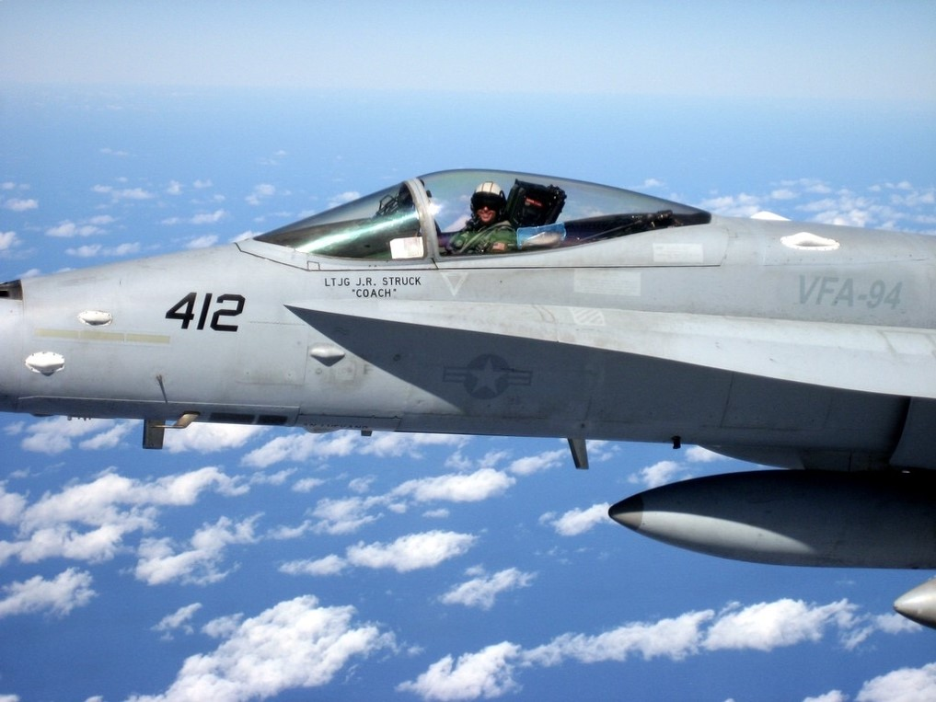
#5 Have fun along the way!
aerofliteinc.com

Slide 13
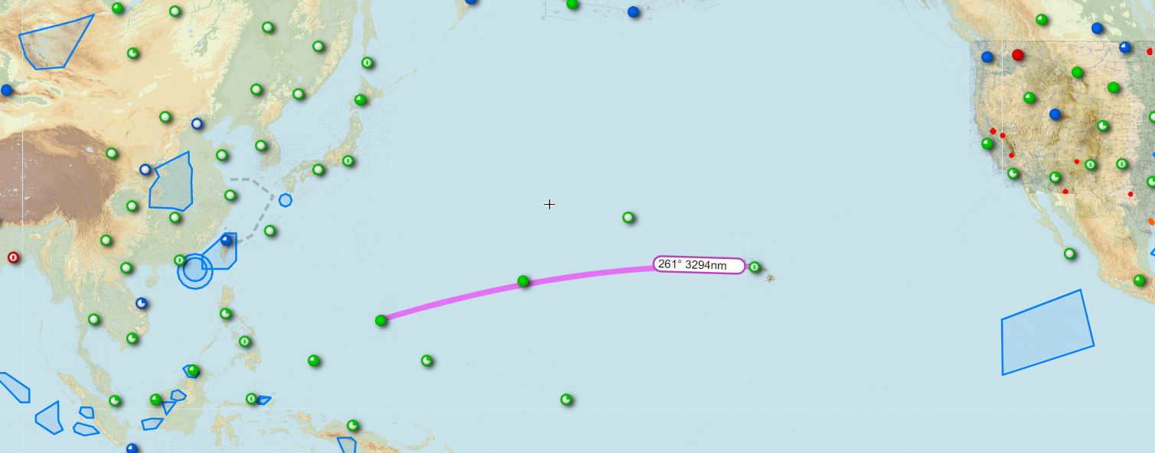
Have fun along the way!
aerofliteinc.com

Slide 14
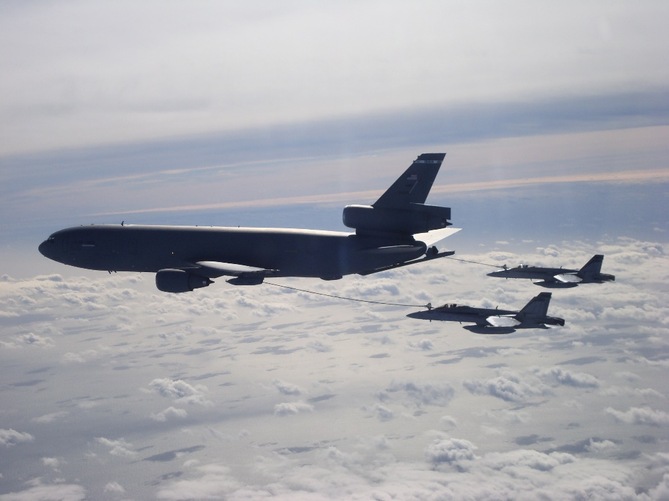
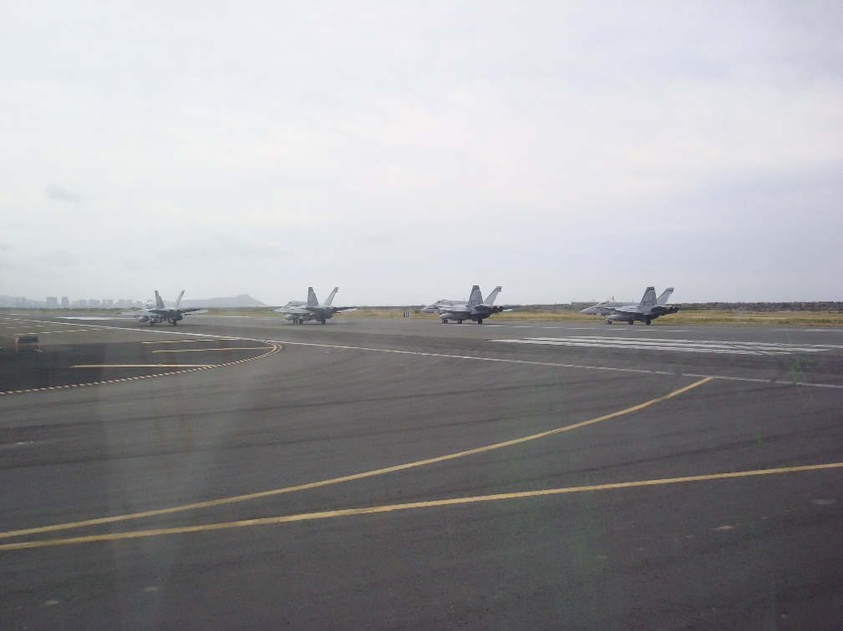
Have fun along the way!
aerofliteinc.com

Slide 15
Have fun along the way!
aerofliteinc.com

Slide 16
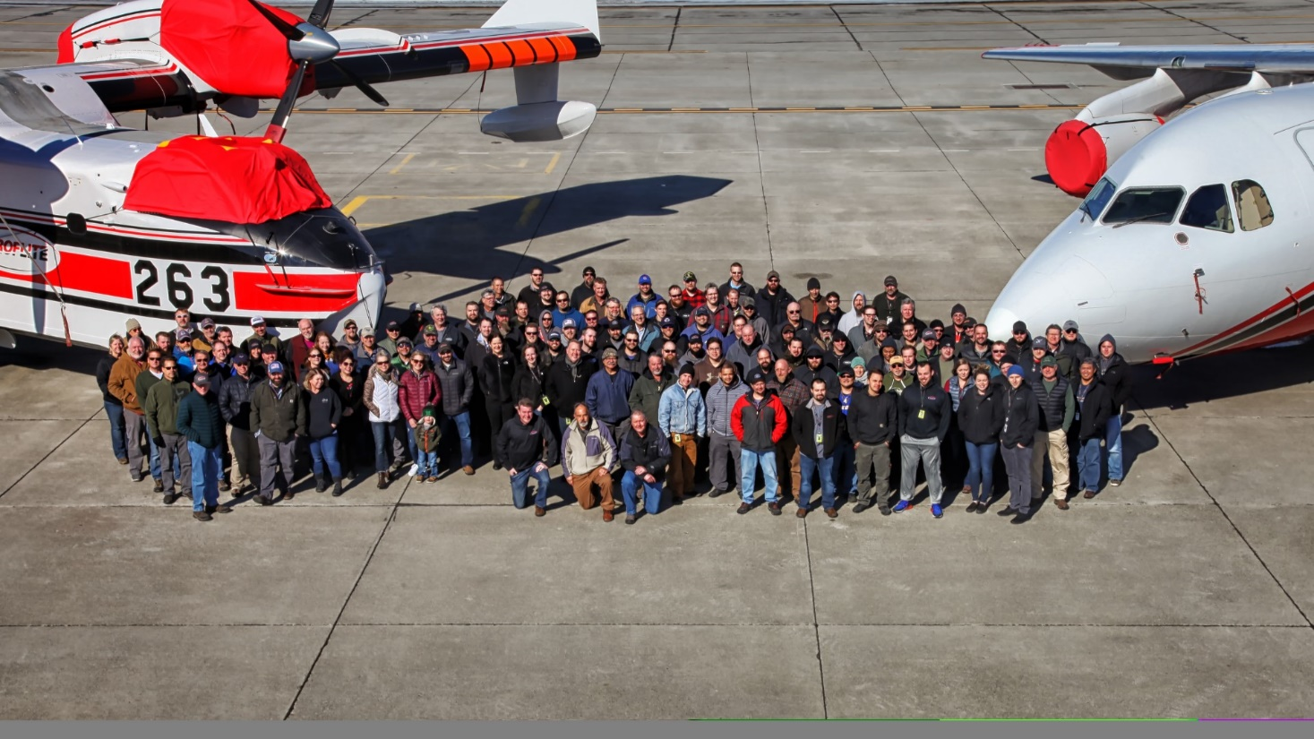
Your most important job
Culture
Not just any culture…
aerofliteinc.com
Notes:
A Positive culture that encourages…
Fosters Great Teamwork… Empowers and Enables People…

Slide 17
Tying it all together
Have a Vision & Purpose
Morale Matters
Leadership is Hard
Empower the Team & Share Credit
Have Fun Along the Way
aerofliteinc.com

